Slide 1

Netflix Data Engineering: S3 Integration and Visualization with QuickSight

Slide 2
OBJECTIVE:
To demonstrate the end-to-end data engineering process of integrating, storing, and visualizing Netflix content data using Amazon S3 and QuickSight, thereby providing valuable insights into the extensive content library and facilitating informed decision-making.

Slide 3





WORKFLOW:
Data
AWS S3
AWS QuickSight

Slide 4
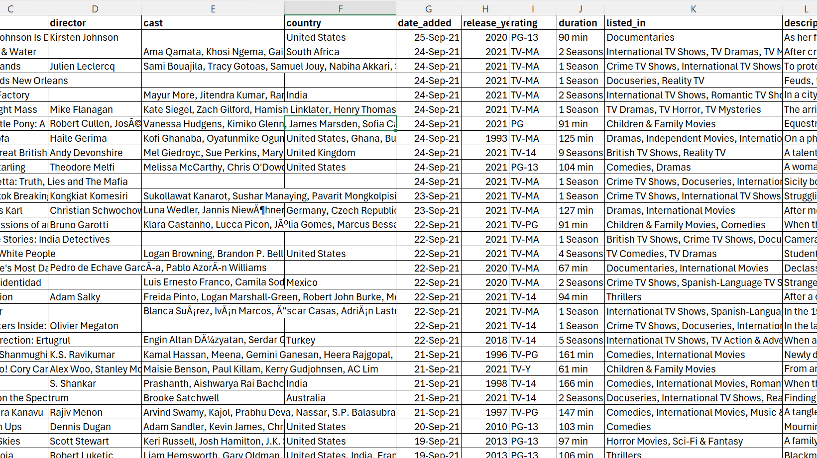
Data
The dataset comprises comprehensive listings of movies and TV shows available on Netflix, including details such as titles, directors, cast, countries of production, release years, ratings, durations, genres, and brief descriptions. This rich dataset offers insights into the diverse range of content offered by Netflix, catering to various genres and audiences worldwide.

Slide 5
Process:
Data Loading:
Load the Netflix dataset into Amazon S3 for efficient storage and accessibility.
Data Connection:
Establish a connection between Amazon S3 and QuickSight to enable seamless access to the dataset.
Data Visualization:
Utilize QuickSight to visualize the Netflix content data, enabling comprehensive analysis and insights generation.

Slide 6

Data Visualization and Insights

Slide 7
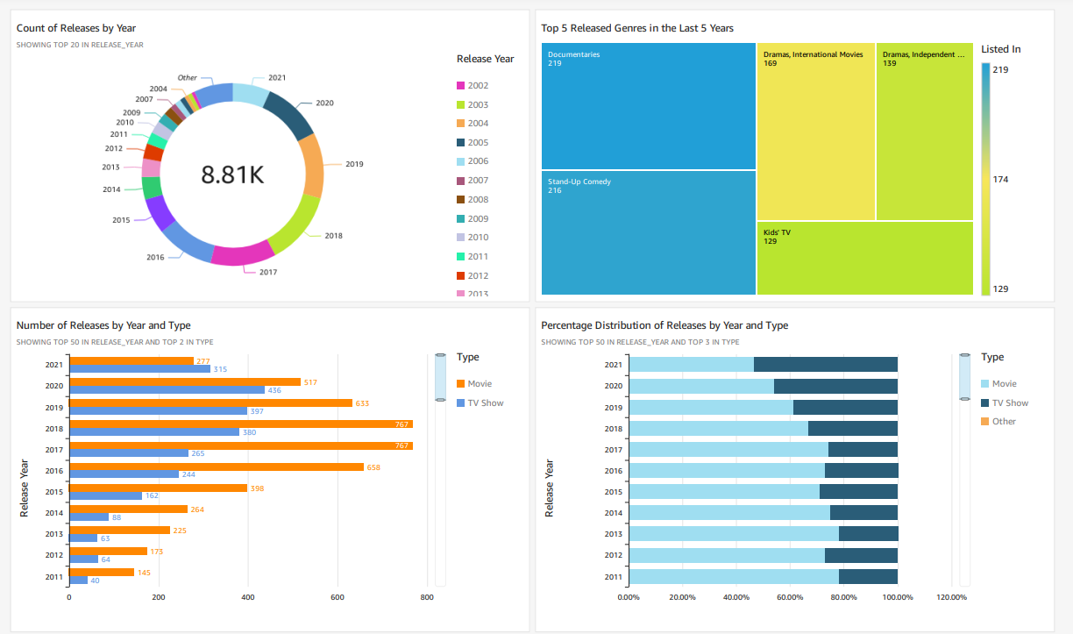

Slide 8
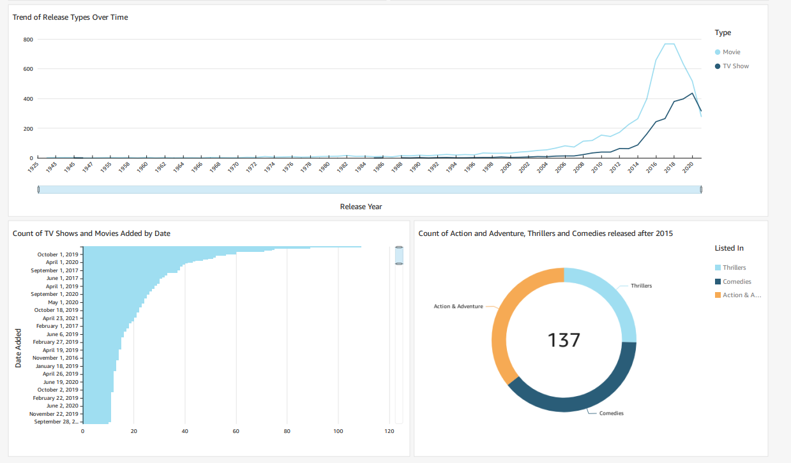

Slide 9
Conclusion:
In conclusion, this project has successfully demonstrated the effectiveness of integrating, storing, and visualizing Netflix content data using Amazon S3 and QuickSight. By following a systematic process of data loading, connection establishment, and visualization, valuable insights have been derived to inform decision-making and enhance understanding of Netflix's extensive content library. Moving forward, these insights can be utilized to drive strategic initiatives and improve user experience on the platform.

